Slide 1

E-commerce Dataset
Analysis & Optimization of Customer Behavior and Sales
Project By:
Ghada Ragab Ali Abdullah (Team Leader)
Abdallah Abdelhafeez Saber Abdallah
Basmala Sherif Sayed Abdelrahman
Basmala Mohamed Rashad Aliwa
Abdulrahman Shehata Osman
Fatma Alzahraa Mohamed

Slide 2

Project Scope & Objective
Problem Statement: The e-commerce platform generates vast amounts of raw data daily. Without proper analysis, customer behavior patterns and revenue opportunities remain hidden.
Our Goal: To transform raw customer and transaction data into actionable business insights using Data Science techniques.
Key Objectives:
Clean and preprocess raw data for accuracy.
Analyze customer demographics and purchasing habits.
Build an interactive dashboard for real-time decision-making.

Slide 3
Project Workflow
Data Collection
Cleaning
EDA
Dashboard

Slide 4
End User and features
End Users:
• Marketing teams
• Business analysts
• E-commerce managers
Key Features:
• Customer segmentation
• Trend analysis & forecasting
• Interactive dashboard

Slide 5
Data Structure
Dataset Format: CSV file containing customer-level data (demographics, activity, spending).
Dataset Shape: Thousands of customer records; 10–25 features per customer.
Key Fields: Age, gender, location, registration date, total spend, purchase frequency, last activity date.
Data Types: Numerical (age, spending), categorical (gender, status), datetime (registration & last purchase).
Data Flow: Import → Clean (types, missing values, duplicates) → Feature engineering → Analysis → Dashboard.
Techniques Used: Handling missing values, outlier checks, encoding categories, date transformations, scaling for clustering.
Value of Structure: Supports segmentation, trend analysis, and clear insights for marketing & business decisions.

Slide 6
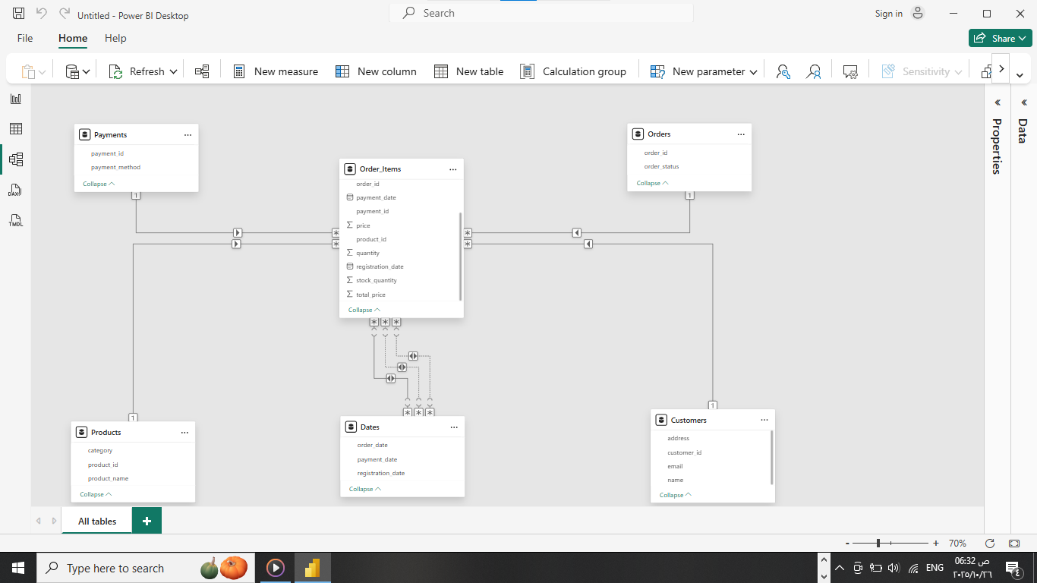
Star Scheme Model For the Data
.

Slide 7
Programming Languages + Frameworks
• Python (Pandas, NumPy, Matplotlib): for cleaning and preprocessing the data
•Power BI : For visualization, analysis and reporting the data
• Excel : For Analysis using Pivot tables and modeling using power pivot the data .

Slide 8
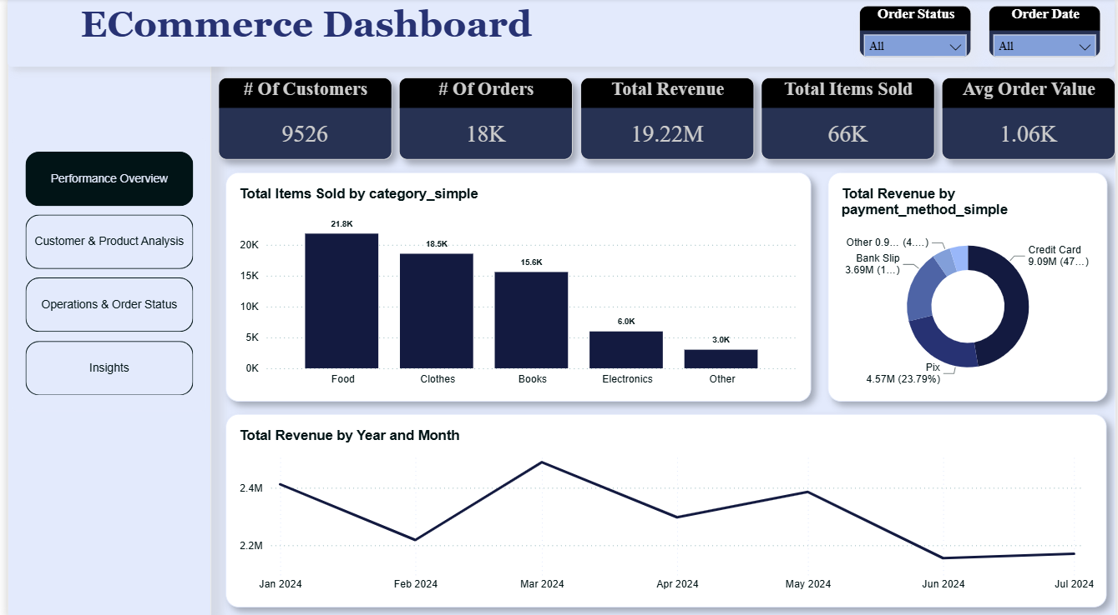
• Cleaned dataset & analysis notebooks
Deliverables
• EDA visuals & segmentation results
• Interactive dashboard
• Final report & presentation slides

Slide 9
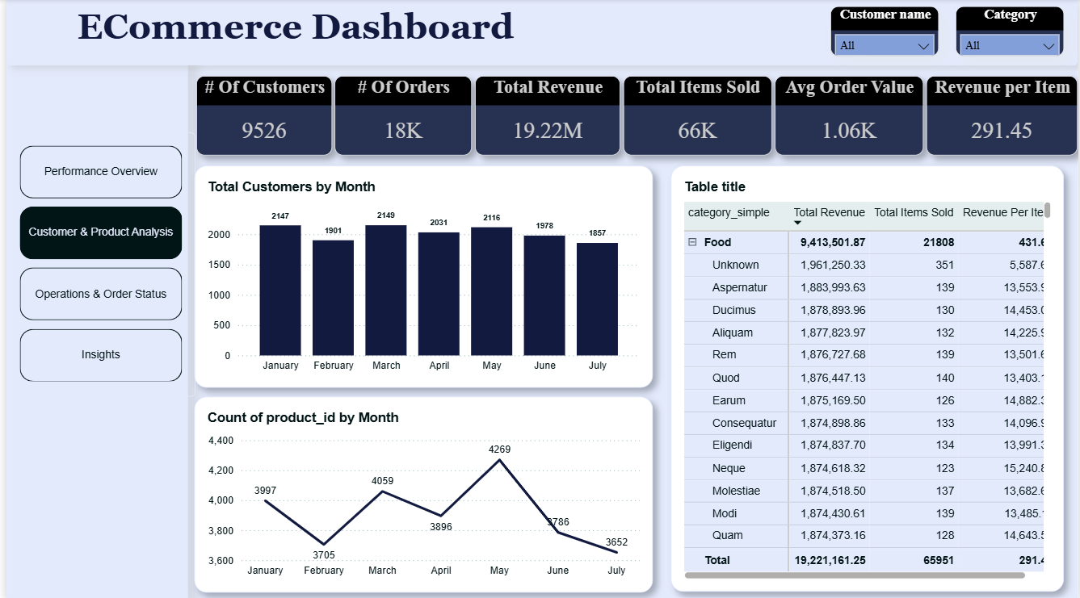

Slide 10
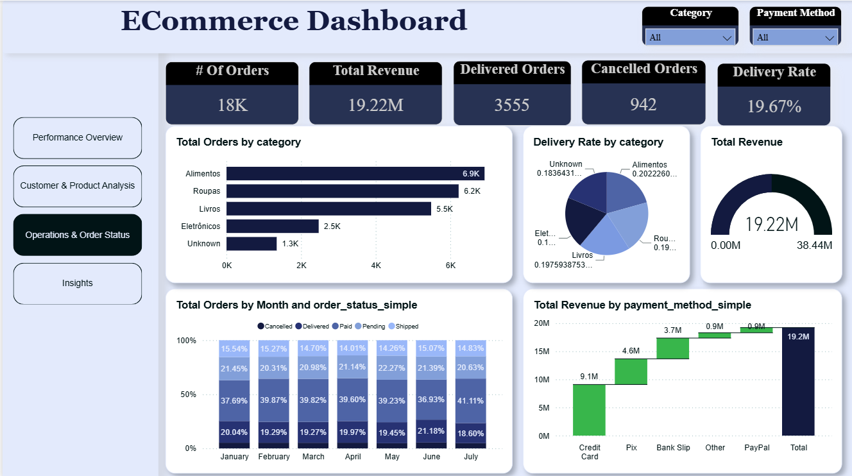

Slide 11
Key Analysis & Insights
Sales Performance: "By analyzing order volumes across categories, we identified distinct performance trends between high-frequency items like 'Alimentos' (Food) and high-value categories like 'Eletrônicos' (Electronics)."
Geographic Distribution: "Using the extracted State data, we mapped customer density to pinpoint underperforming regions versus high-growth markets for targeted logistics improvements."
Payment Preferences: "We examined the distribution of payment methods—specifically comparing Credit Card, Boleto, and Pix—to understand customer financial behaviors and checkout preferences."
Order fulfillment: "We tracked the 'Order Status' lifecycle from 'Pending' to 'Delivered' to identify potential bottlenecks in the supply chain."

Slide 12
Project Team + Roles
• Ghada Ragab Ali Analysis & Insights (Team Leader)
• Basmala Sherif Cleaning & Preprocessing
• Abdallah Abdelhafeez Cleaning & Preprocessing
• Basmala Aliwa Dashboard Development
• Abdulrahman Shehata Dashboard Development
• Fatma Alzahraa Analysis & Insights

Slide 13
Thank You
Questions or feedback are welcome!
Feel free to contact me
abdallahabdelhafeez2004@gmail.com

